Slide 1
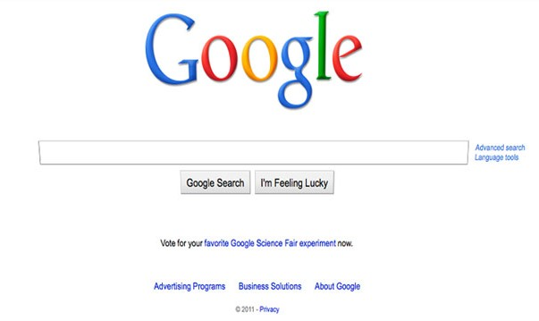
How does Google or any other
site get to know what
you have entered in search box?

Slide 2
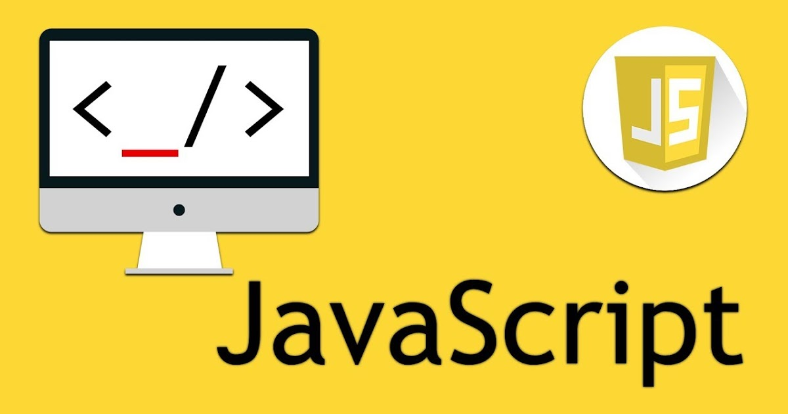
Made By: Prajjwal Pandey

Slide 3

What is JavaScript?
Java and JavaScript not similar.
Old Name: LiveScript in September 1995, renamed as JavaScript in December.
Interpreted Programming Language: without compiling a program into machine-language instructions
dynamic, weakly typed.

Slide 4
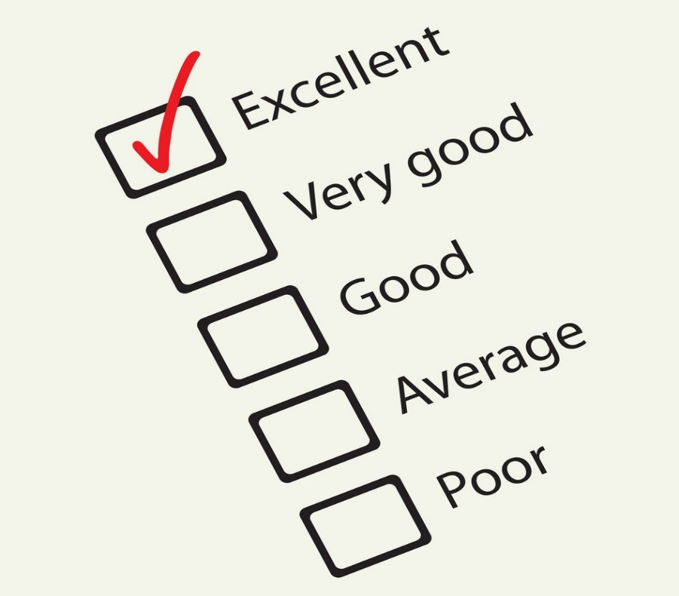
Why should we use JavaScript?
JavaScript is one of the 3 languages all web developers must learn:
1. HTML : defines the content of web pages
2. CSS : specifies the layout of web pages
3. JavaScript to program the behavior of web pages
Feedback form

Slide 5
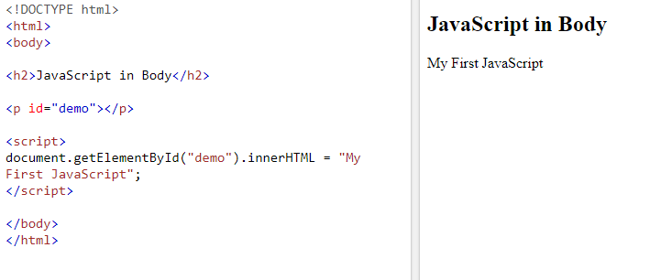
How to use JavaScript in your HTML?
In HTML, JavaScript code must be inserted between <script> and </script> tags.

Slide 6
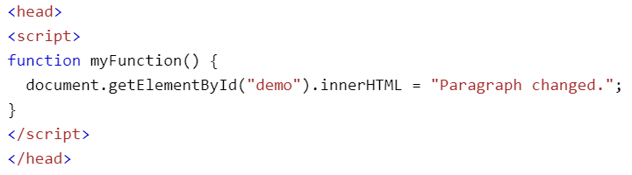
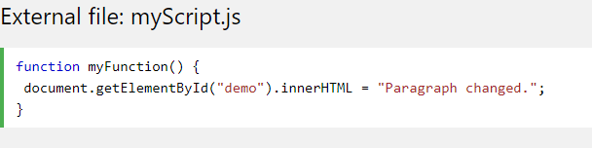
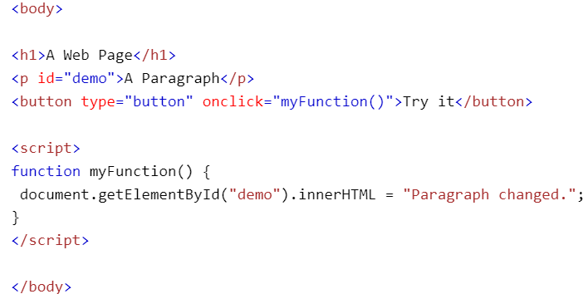

Ways to use JavaScript:
JavaScript in <head>
JavaScript in <body>
External JavaScript

Slide 7
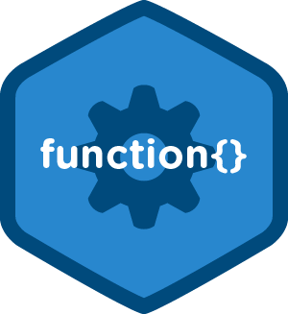
JAVASCRIPT FUNCTIONS

Slide 8
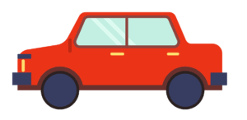
What is a Function?
Functions : fundamental building blocks in JavaScript
Function : JavaScript procedure i.e a set of statements that performs a task or calculates a value.
Types: 1.predefined functions 2.user defined functions.

Slide 9
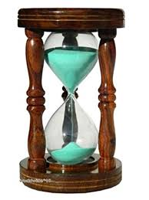
Why do we need Function?
Not functional:
var name=“Prajjwal”;
var greeting=“Hi, I’m”;
console.log(greeting + name);
OUTPUT=>
Hi, I’m Prajjwal

Slide 10
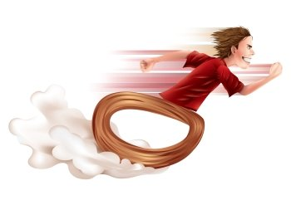
Functional (User defined function)
function greet(name){
return “Hi, I’m” + name;
}
greet(“Prajjwal”);
OUTPUT=>
Hi, I’m Prajjwal

Slide 11
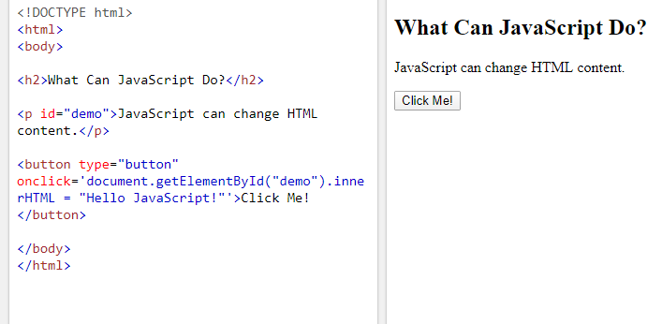
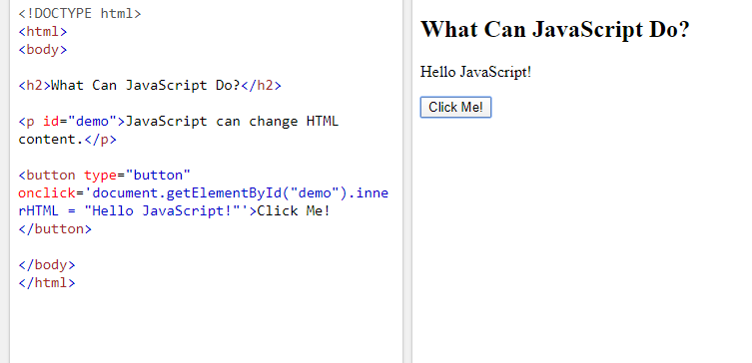
Predefined Functions
One of many JavaScript HTML methods is getElementById().

Slide 12

Some more predefined functions:
Writing into the HTML output using document.write().
Writing into an alert box, using window.alert().
Writing into the browser console, using console.log().

Slide 13

TAKEAWAYS
JAVASCRIPT interpreted programming language, dynamic & weakly typed
Used to define behavior of pages & code inserted between <script> tags
3 ways : <body>,<head>,external
Set of statements that performs a task
Predefined functions And user defined functions

Slide 14
THANK YOU

